Slide 1
Mix It Up
1st Birthday Party!

Slide 2
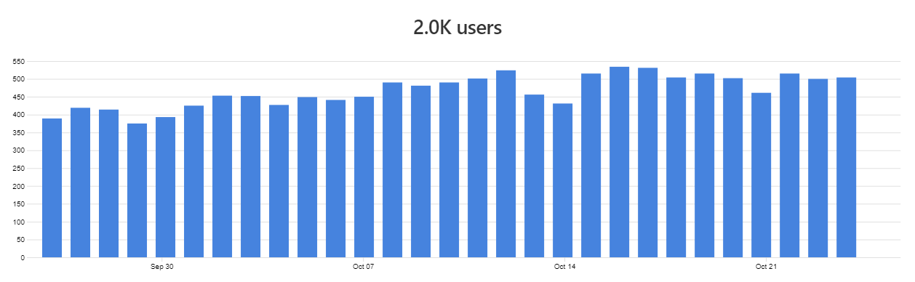
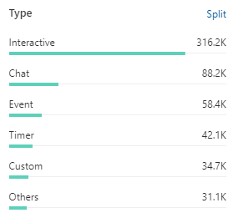
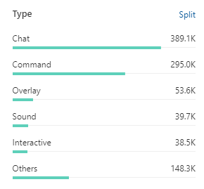
Over the last 30 days, we’ve 2000 unique users try Mix It Up.
We also average around 500 unique users every day.
Over the last 14 days:
570,000 commands have been run
964,000 actions have been run

Slide 3
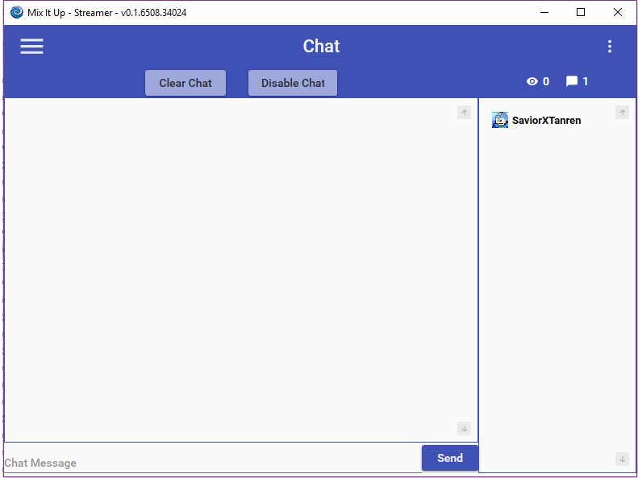
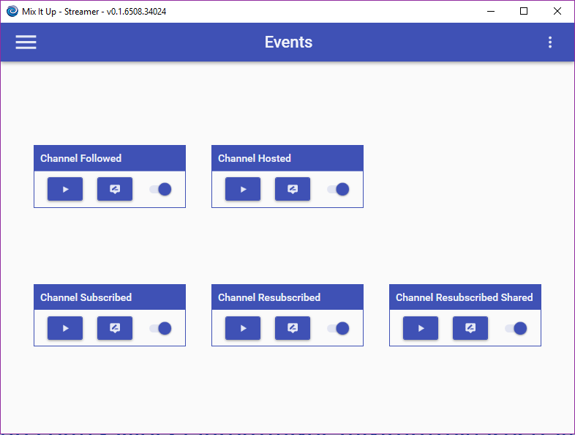
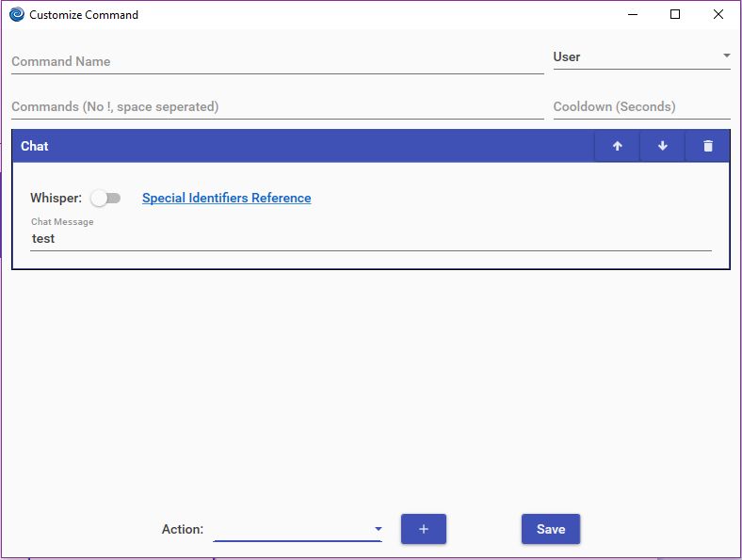
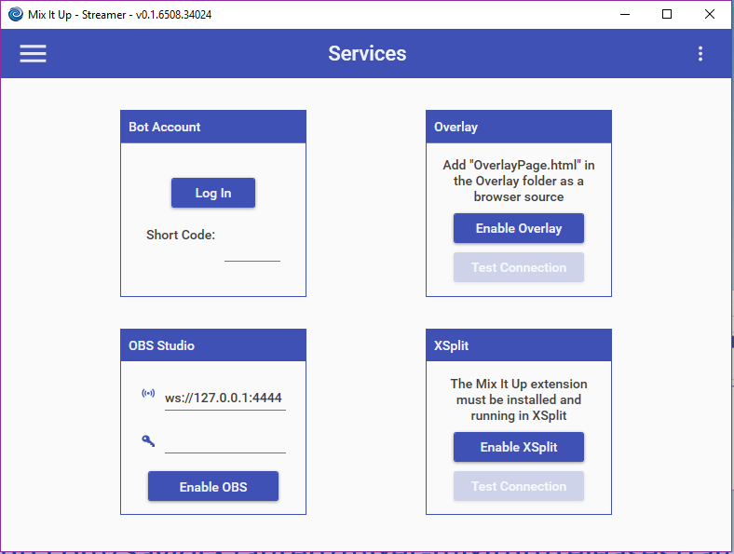
Where did it all start?
Want to see how bad it was?
https://github.com/SaviorXTanren/mixer-mixitup/releases/tag/0.1

Slide 4
Where are we now?
27 different types of actions
Full connectivity with all major streaming software
Connectivity with 8 different external services
Some of the best users in the world!

Slide 5
What’s coming up?
Stream Avatars – Integration with commands & currency, released TODAY!
Overlay Widgets – The ability to show “static” content on your Overlay, such as goals, event lists, stats, & more
Stream Deck – The ability to run commands directly from your Elgato Stream Deck
Mix It Up Remote – A free, mobile phone version of a stream deck that can be used with Mix it Up

Slide 6
What about the future?
Integrate with more services (EX: Player.me, Patreon)
Improve current service integrations (EX: Twitter Likes & Retweets)
Developer SDK to allow users to build their own Commands & Actions + share them with the community
Localization for Spanish & Japanese
And more to announce here…

Slide 7
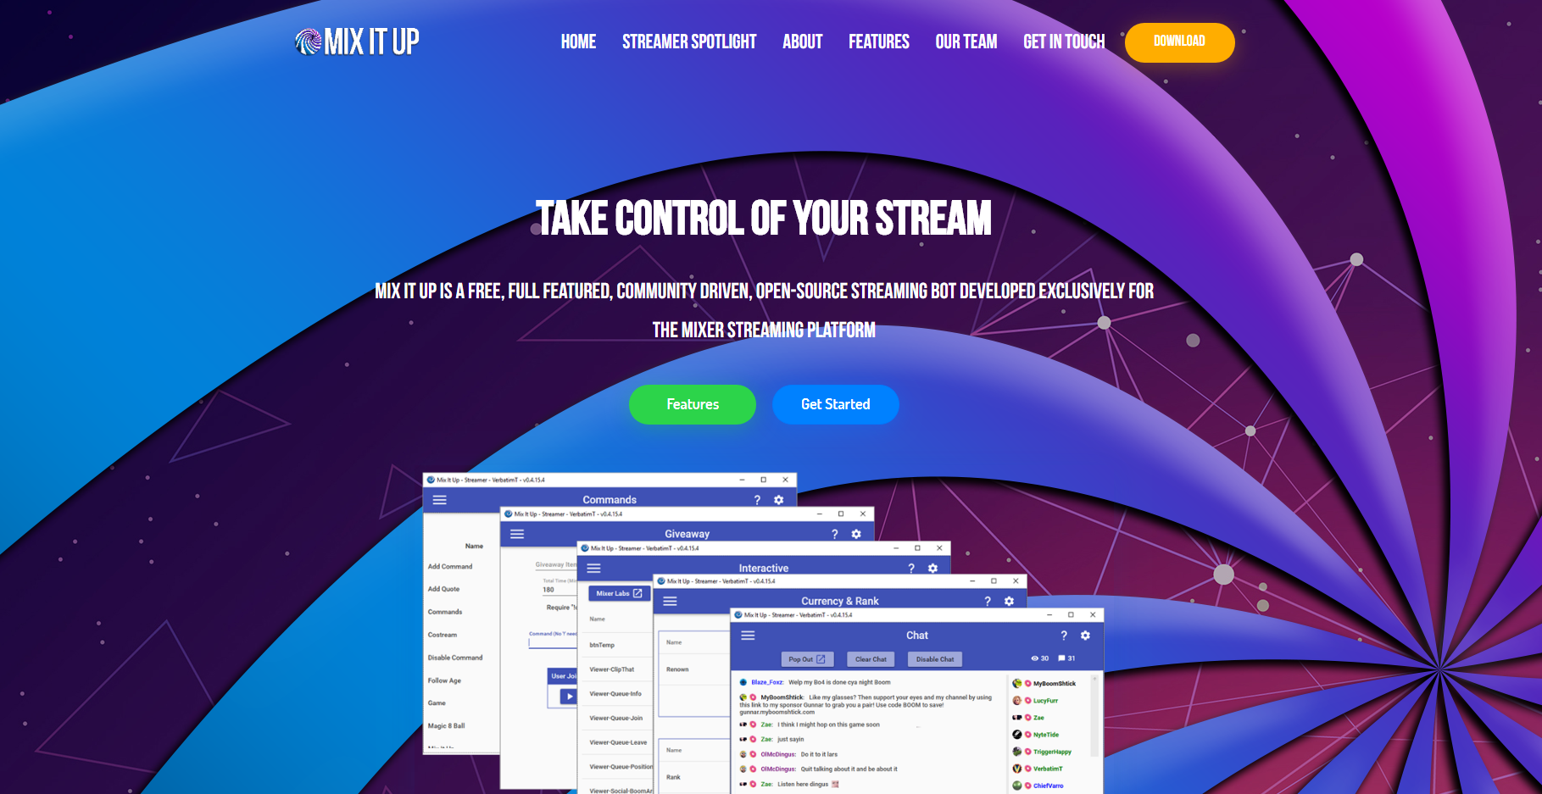
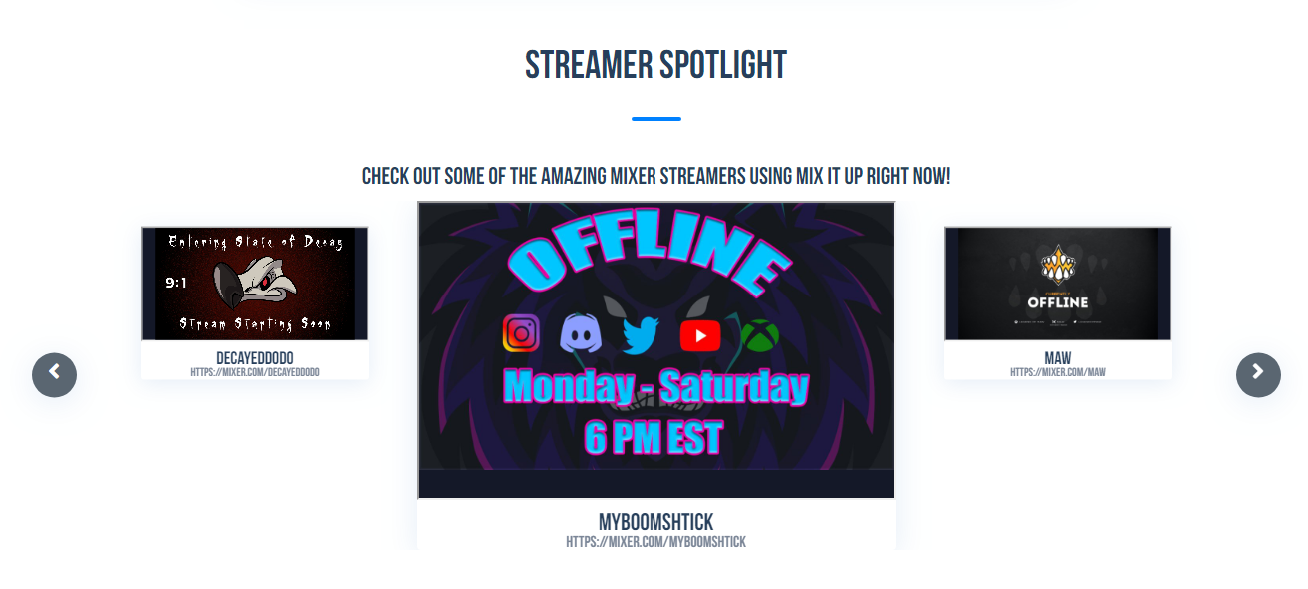
New Website
Since it’s our 1 year anniversary, we decided the website could use a nice face-lift
We also have FINALLY implemented our “Feature Me” option in the Settings menu!

Slide 8
The Bounty System
Providing resources for new users is difficult balance with active feature development
We know some our users already create awesome content about Mix It Up via the Mix It Up Store & YouTube videos
We want to help reward users & provide spotlight to these people by creating targeted & timely “bounties” for resource content
EX: Create a video on Games for a chance to win an Xbox game

Slide 9
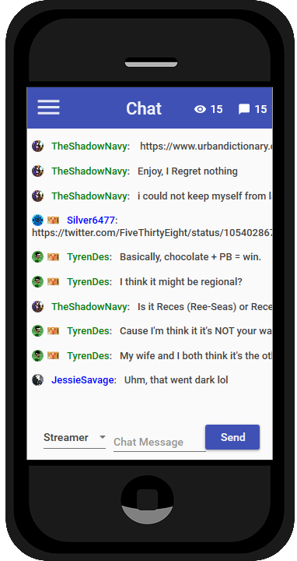
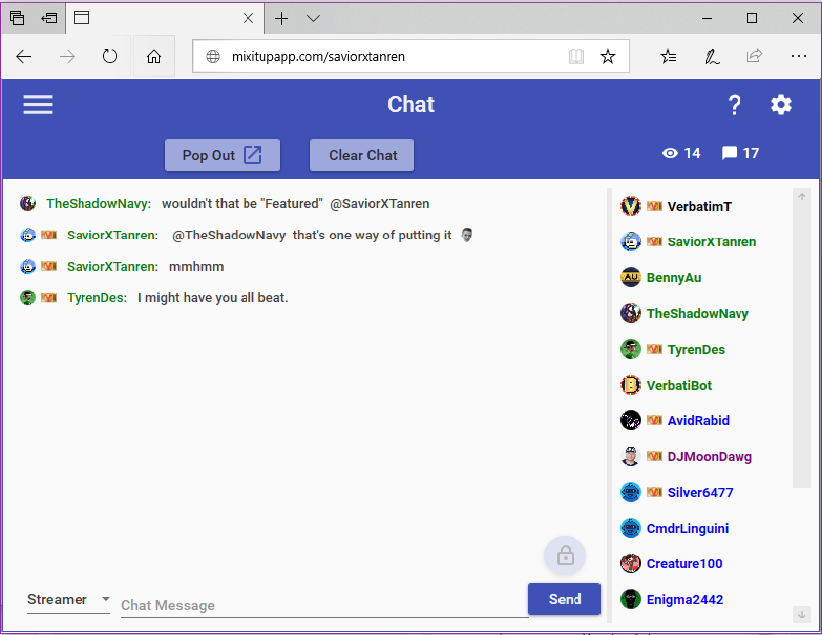
2 new ways to use Mix It Up
Mix It Up Mobile Mix It Up Online

Slide 10
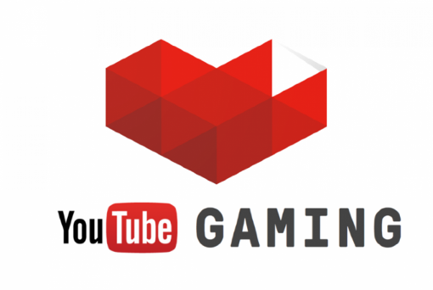
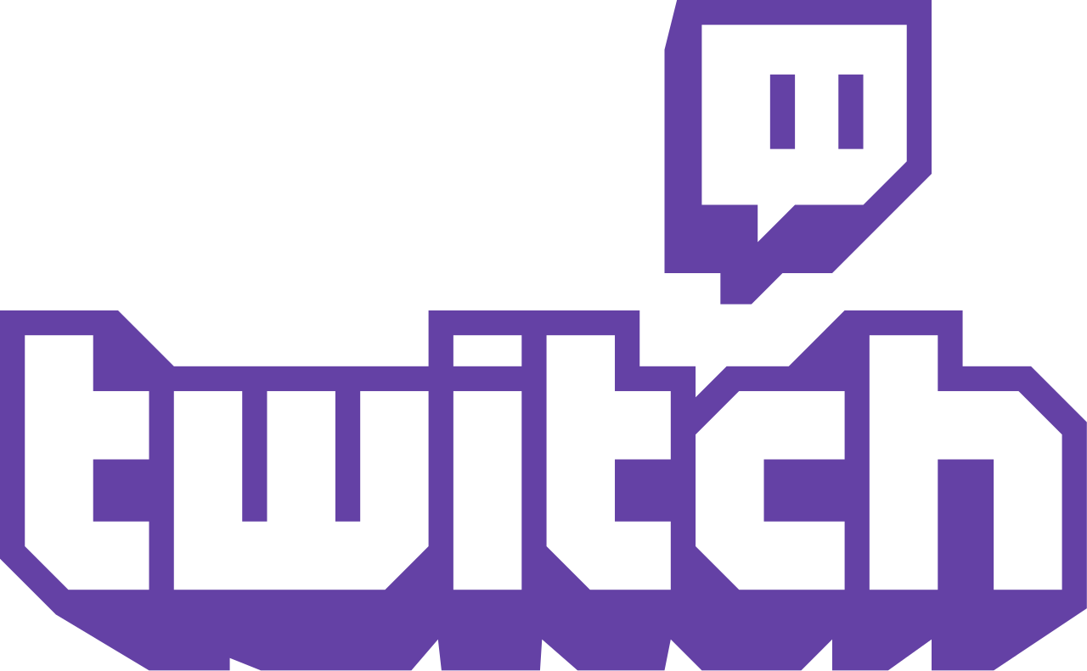
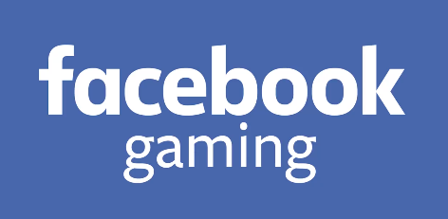
New platforms being investigated
A day of “one platform” just isn’t the case anymore with most streamers. Using multiple platforms to help bring in your audience is now the norm and we want to support that.
One thing we want to make clear, this doesn’t change where everything started. We still plan to keep Mixer as the priority platform, but this would help provide better opportunities for our users.

